Slide 1
Chaos Engineering
Working Group
A proposal for the CNCF
Sylvain Hellegouarch / ChaosIQ

Slide 2
A Chaos Engineering Haiku
We love our systems
They tend to fail all the time
Don’t turn a blind eye

Slide 3
The story of a man and his phone
Based on true events!
A man takes security seriously.
2FA is setup on all his accounts
He's using Google Authenticator
Serious we say.

Slide 4
A lesson learnt
Phone dies (faulty battery, who could predict?)
"Oops!", the man says. Can't produce 2FA codes any longer.
Obviously, the man was careless and did not produce spare codes.
A lesson is learnt. One he shall never forget.
Don't bet on a single device for 2FA.

Slide 5
Shocking event occurs!
(New) phone is stolen.
"Hah!" the man says, "I'm using my laptop to generate codes!"
Phone was stolen in a foreign country and laptop is home.
"Oh!" the man says pointidely.
Worse part, all accounts are directly accessible on phone but can't be disabled because codes are needed to connect from different device.
Obviously, man was again careless and did not print spare codes.
A new lesson is learnt, "print stupid codes!"

Slide 6
To be continued

Slide 7
A point to this sophisticated story?
Unexpected events occur.
Getting familiar with the unexpected could save your bacon.

Slide 8
By the way - Credits
Sylvain Hellegouarch as “The man”

Slide 9
Let’s start somewhere
Chaos Engineering is the discipline of experimenting on a distributed system in order to build confidence in the system’s capability to withstand turbulent conditions in production.
Principles Of Chaos
Reference http://principlesofchaos.org/

Slide 10
Failure free operations require
experience with failure
Recognizing hazard and successfully manipulating system operations to remain inside the tolerable performance boundaries requires intimate contact with failure.
How complex systems fail / Richard I. Cook
Reference http://web.mit.edu/2.75/resources/random/How%20Complex%20Systems%20Fail.pdf

Slide 11
Some context

Slide 12
Netflix - The Origins
Exploring internally (2008/2012)
Sharing (2012)
Chaos Monkey OSS
Organizing (2014)
Recruiting a Chaos Engineer
Educating (2016/2017)
Principles of Chaos
Chaos Engineering book
More details at: https://www.gremlin.com/community/tutorials/chaos-engineering-the-history-principles-and-practice/

Slide 13
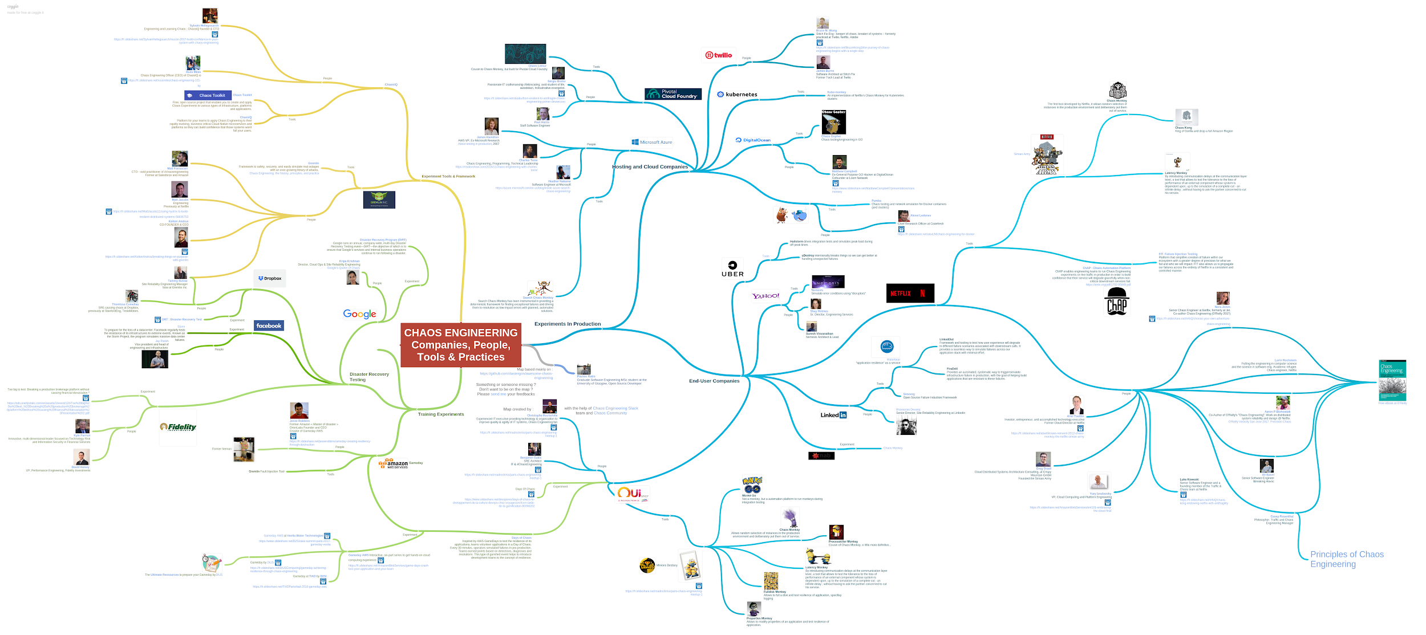
Now, it’s a whole world!
Source https://goo.gl/Pj8dwQ

Slide 14
So why Chaos Engineering?

Slide 15
Cost of ignoring weaknesses existence exceeds cost of unearthing them proactively.

Slide 16
Pitfalls everywhere
Systems grow in complexity (so fast):
More moving parts
Interdependence: from inside and outside the system
Changes at a fast pace
Security not an afterthought anymore
Stricter Regulations: GDPR
Reliance on pieces we don’t control
Weaknesses have subtle ripple effects
Blaming culture rather than questioning the system’s potential for failure

Slide 17
Benefits of Chaos Engineering?
Proactiveness increases confidence in systems and trust in teams
Improves system availability and safety
Happy and trusting users!

Slide 18
Why a CNCF Working Group?

Slide 19
Why a CNCF a Chaos Engineering Working Group?
A natural encounter.
CNCF has laid solid foundations for powerful community and industry collaboration.
Chaos Engineering is a socio-technical discipline to learn about systems weaknesses through experimental cooperation.

Slide 20
Working Group Objectives
Goals
Federate the industry and create educational material
Propose an industry-wide definition that users can make their own
Provide a white paper and update the CNCF landscape with a new category
Discuss the ethics of doing Chaos Engineering
Discuss, and potentially come up with, an API specification for platform and application native Chaos Engineering operations
Non-Goals
This is not a standard body and we won't be creating standard
We will not try to bless one project over the other

Slide 21
Next steps?
Listen to the CNCF community
On the CNCF Slack #chaosengineering channel
Propose the Chaos Eng WG to the CNCF TOC in June/July
Organize regular meetups (stream-based)
Follow the CNCF rules regarding WG

Slide 22
Want to join the discussion?
Please add yourself to the proposal if interested!
Join the first meeting
Talk with the CNCF community on https://slack.cncf.io/ #chaosengineering
Join some of the public forums on the topic:
https://groups.google.com/forum/#!forum/chaos-community
https://chaosengineering.slack.com

Slide 23
United we stand better
Systems are complex and the challenges we face, as engineers, are overwhelming. We need to come together and learn as a group.

Slide 24
Thank you all for listening!

